Slide 1
Computers are Blind
A lesson on Virtual Machines and program execution

Slide 2
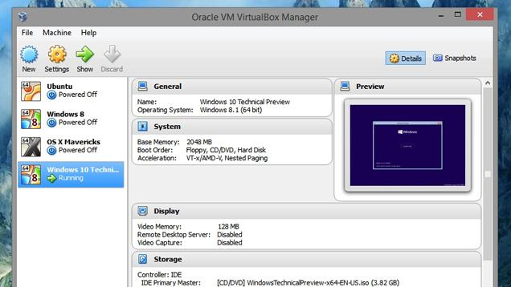

No, I’m a Virtual Machine!
I’m a Virtual Machine!

Slide 3
No, I’m a Virtual Machine!
I’m a Virtual Machine!

Slide 4
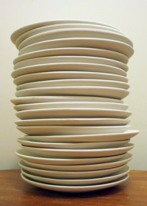
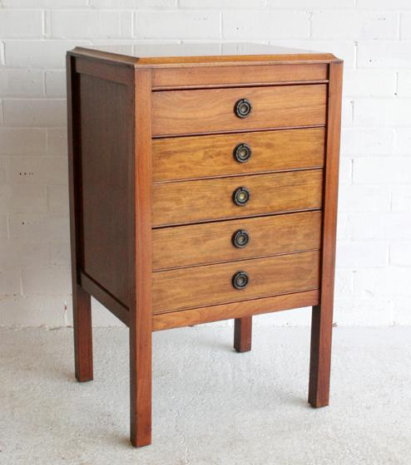
=
+

Slide 5
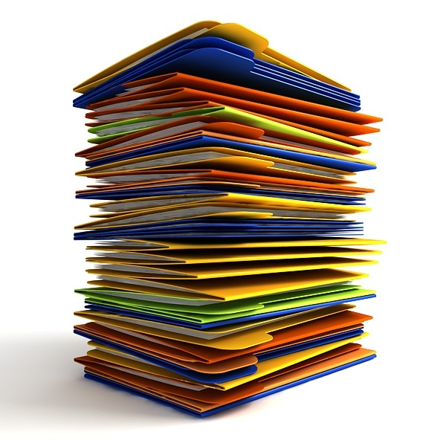
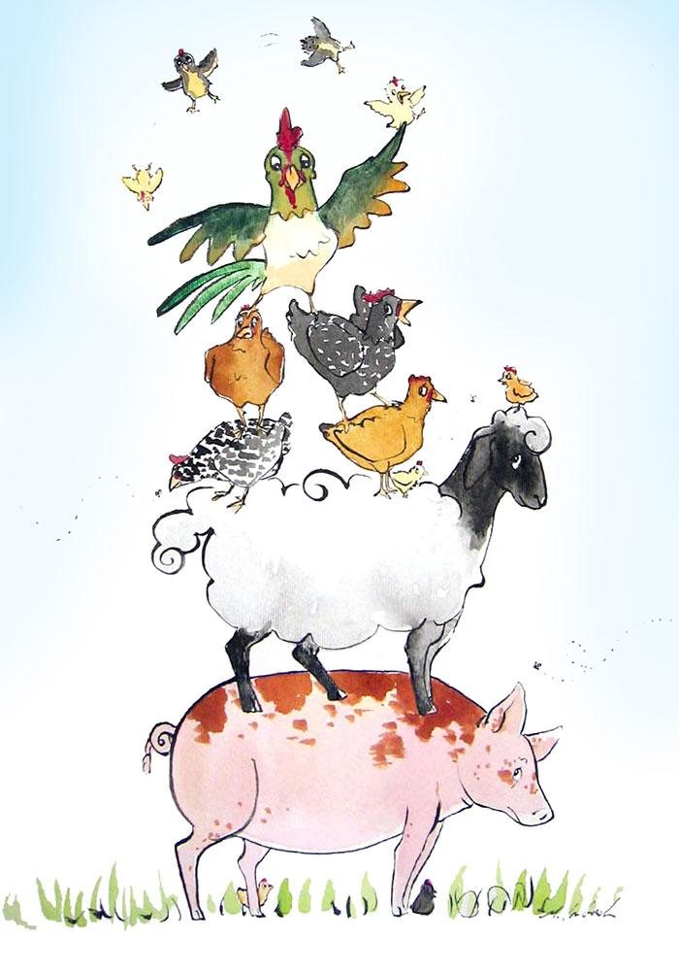
Stack
Stack frames

Slide 6
Heap
Heap addresses

Slide 7
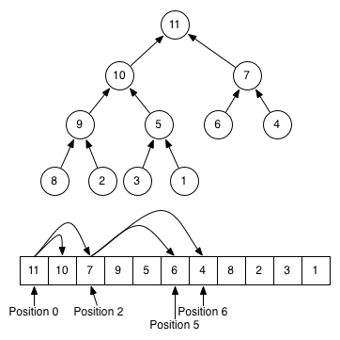
Heap

Slide 8
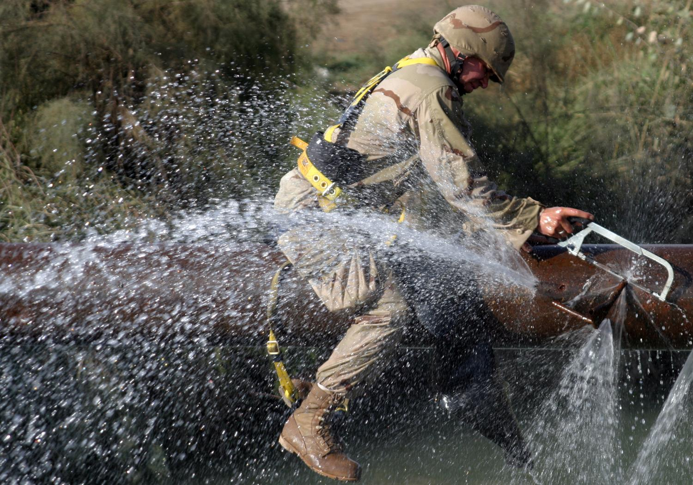
Function Definition
Function Call
A plumber is a tradesperson who specializes in installing and maintaining systems used for potable (drinking) water, sewage and drainage in plumbing systems. The term dates from ancient times, and is related to the Latin word for lead, "plumbum".^{[1][2]}

Slide 9
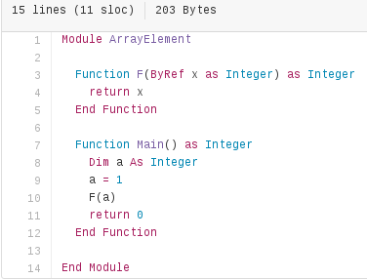
←objects
function calls →
Heap
Stack

Slide 10
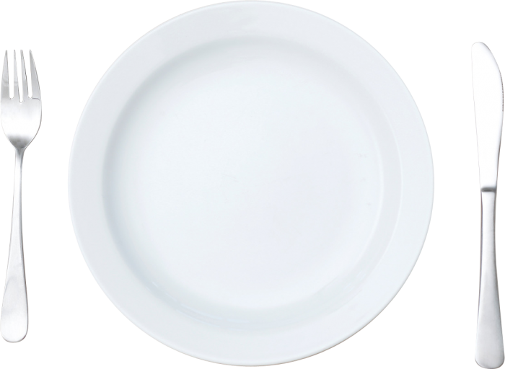
Stack Frame
Function name
variable names → heap addresses
Current line number

Slide 11
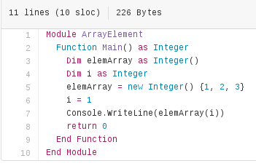
Stack frame
Heap
0
function name: Main()
variables:
i → 0
elemArray → 1
Current line number: 6
1
2

Slide 12
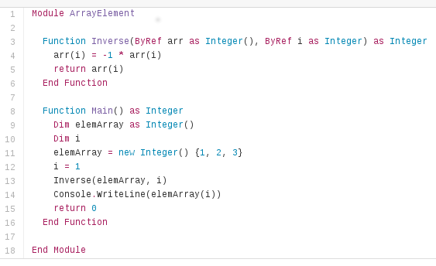

Slide 14
Programmer sees:

Slide 15
Computer sees:

Slide 16
The game
Group in a team of 2 or 3 each
Follow the guidelines in your handout
You are given:
a stack
a heap
a program
*&&&&
Execute the program
What is your result?

Slide 17
Virtual Machines

Slide 18
Conclusion
What is a stack?
What is a heap?
What is a stack frame?

